Slide 1
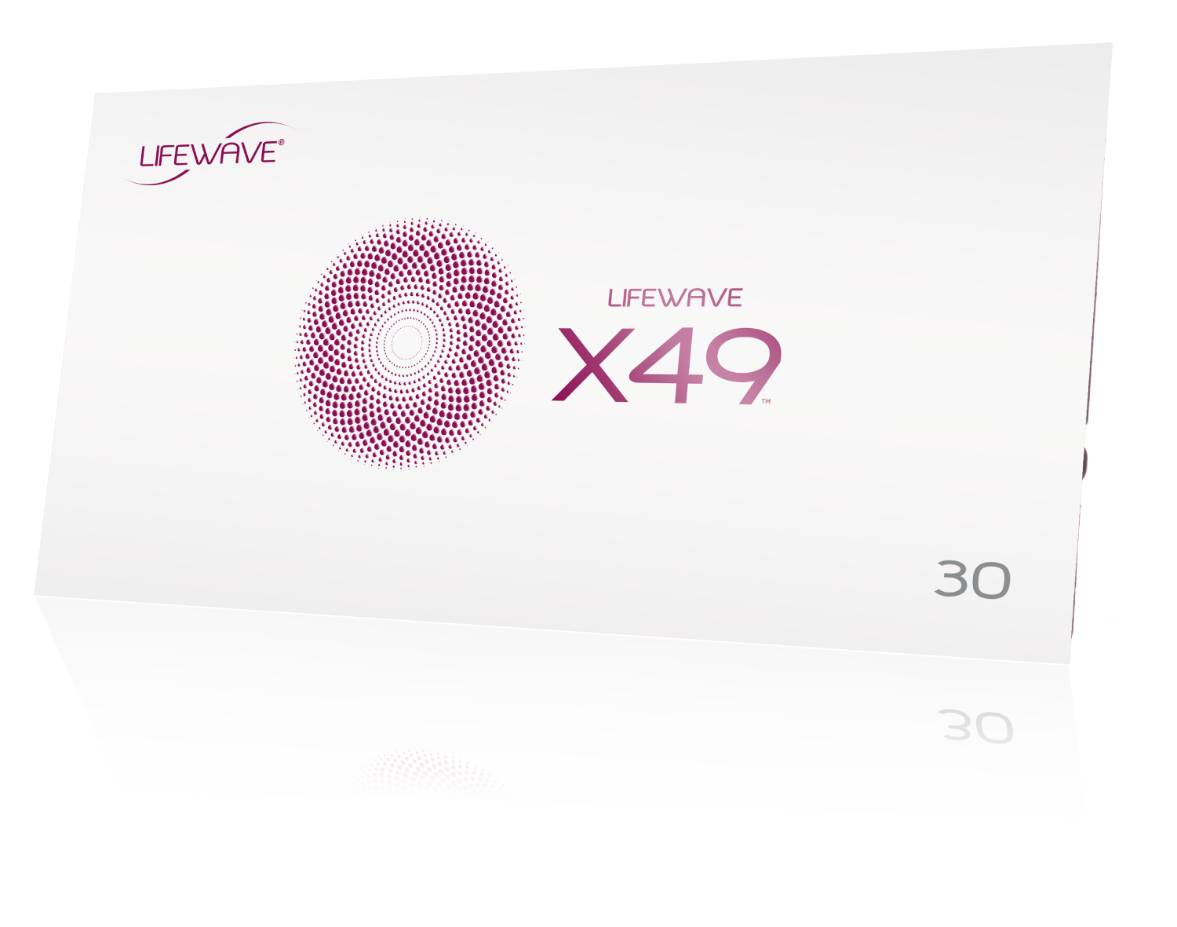
X49™ Product Education

Slide 2





Presentation Overview
Product Benefits Overview.
Why is X49™ the perfect companion to X39®?
What benefits can I expect from X49™?
What benefits can I expect from using X39® and X49™ together?
Performance Bundle.

Slide 3
Product Benefits Overview
X39® + X49™
X49™ is most powerful when used with X39®, so let’s first do a quick overview of the benefits of each product.

Slide 4
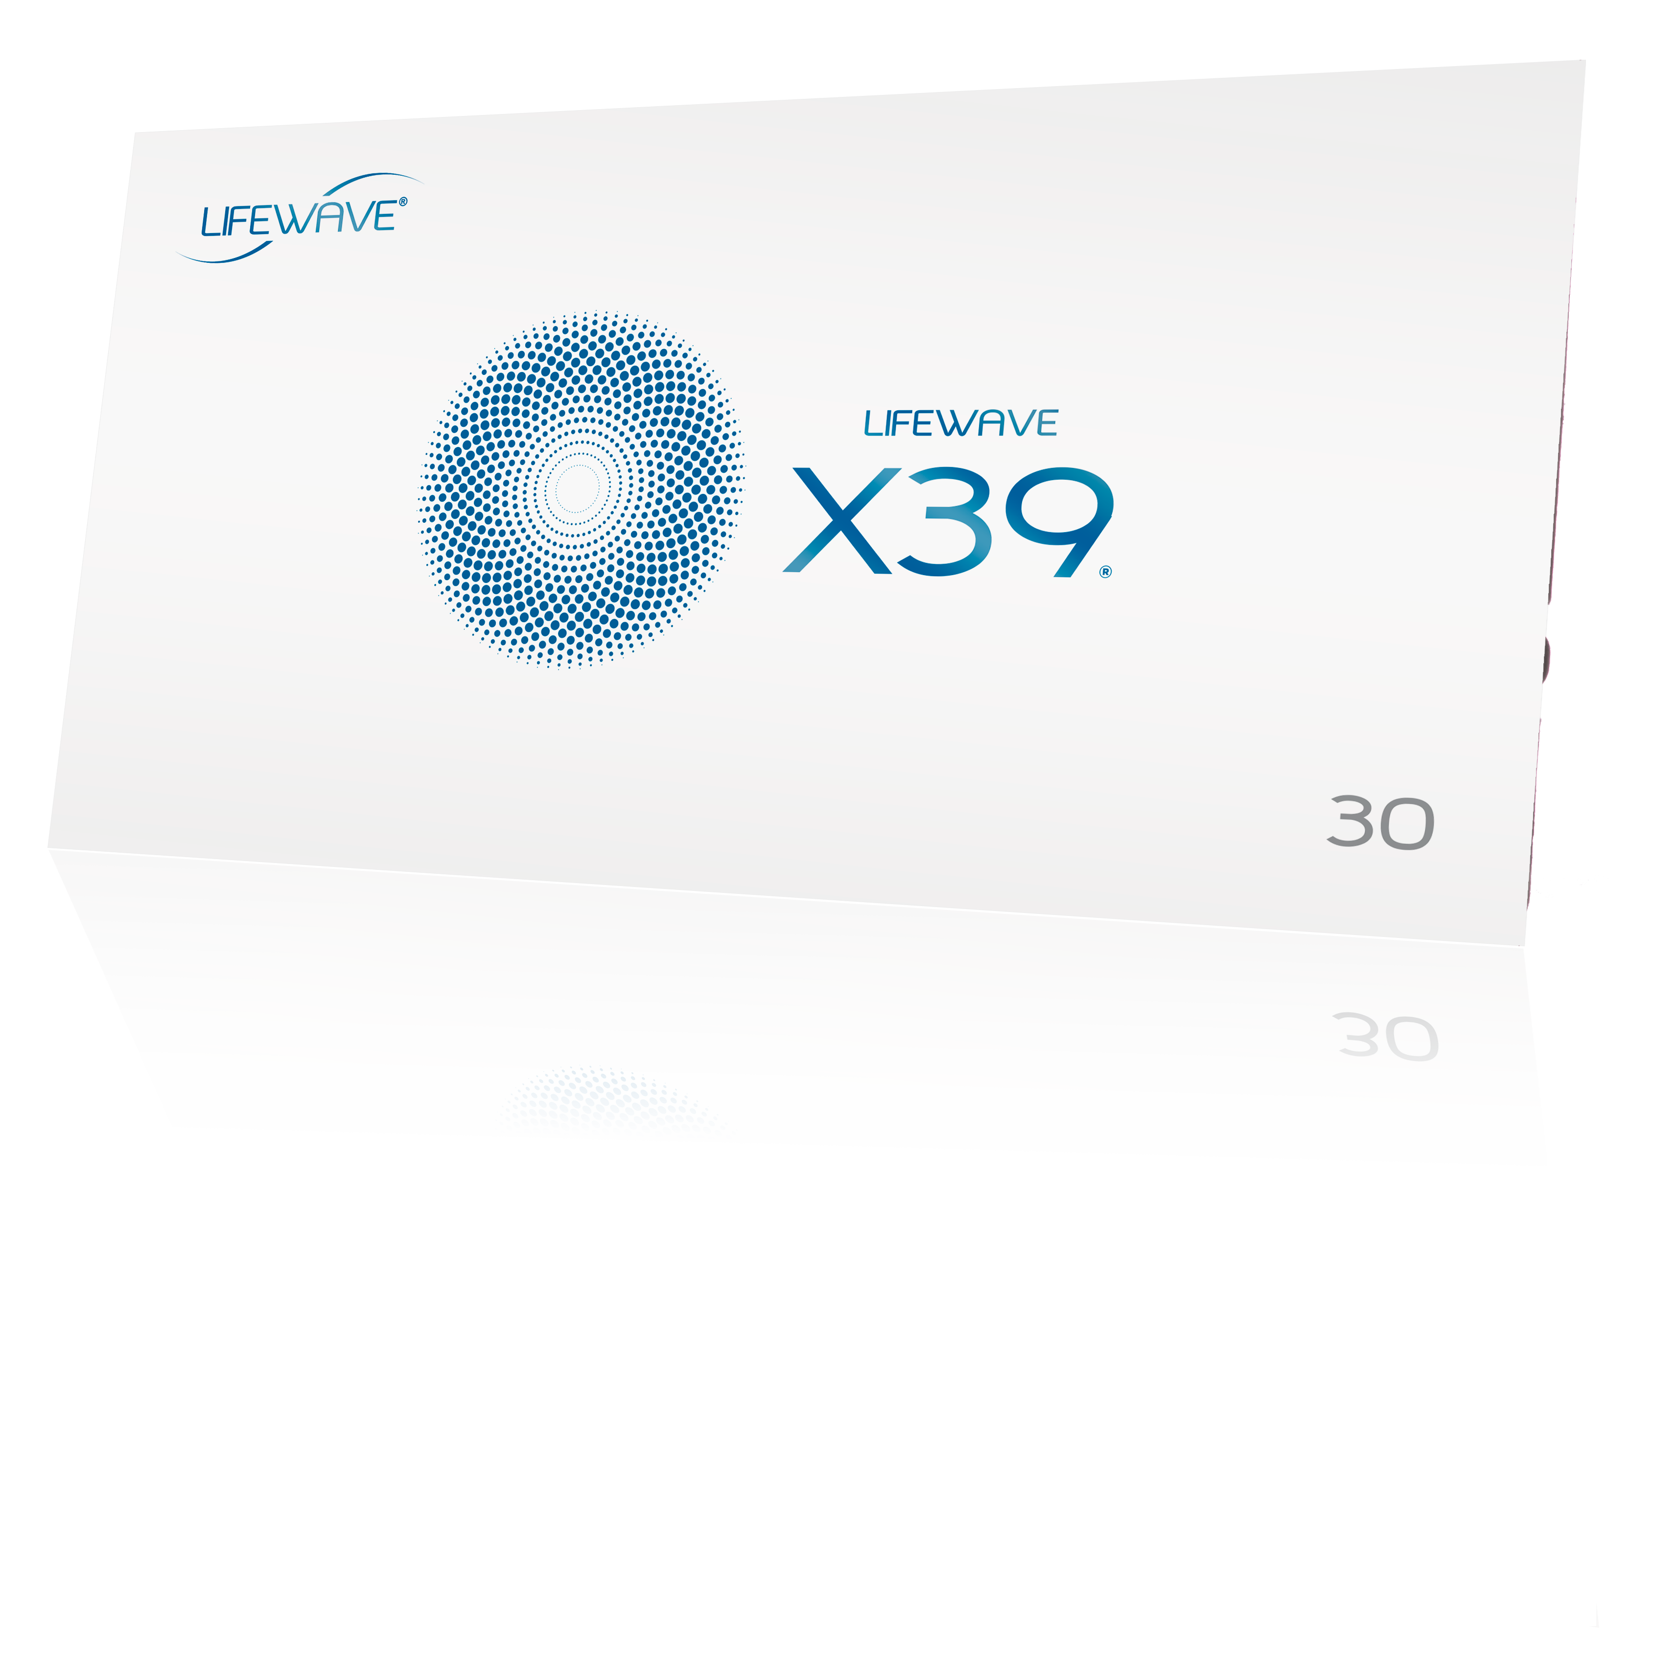
X39® Benefits
The main benefit of X39® is stem cell activation and enhancement, leading cells to behave as younger, healthier cells. This leads to:
Increased energy and better sleep.
Supports the immune system.
Relief of minor aches and pains.
Improved Cognition.
Improved skin quality, reducing the appearance of lines and wrinkles.
Supports natural wound healing process.

Slide 5
X49™ Benefits
The main benefit of X49™ is promoting an increase in performance in strength and stamina. More specifically, it supports:
A healthy cardiovascular system.
Healthy cognitive function.
Muscle Recovery.
Fat loss when used in tandem with a healthy diet and exercise program.
Bone health.

Slide 6
Why is X49™ the perfect companion to X39®?

Slide 7
How is X49™ different than X39®
X39® elevates GHK-Cu
X49™ elevates AHK-Cu
AHK-Cu is the daughter peptide to GHK-Cu and offers a number of unique benefits when it comes to stem cells and health.

Slide 8
X49™ and AHK-Cu
Like X39®, AHK-Cu is a copper peptide and is found in the blood of most mammals.
AHK-Cu has been found to be involved in the health of the vascular endothelial cells (lining of blood vessels).

Slide 9
X49™ and AHK-Cu
AHK-Cu has been researched for many years in the skincare industry.
In addition, new research shows AHK-Cu is as effective as minoxidil for regrowing hair, although we do not make that claim.
Our own research into AHK-Cu has found that, because of it’s ability to metabolize the amino acid Alanine, offers unique benefits that perfectly compliment X39®

Slide 10
Blood samples to measure AHK-Cu concentrations were taken at baseline, 24 hours and at 7 days of wearing the patch. A sample of convenience of 10 subjects made up of both men and women aged 40-81 were selected to participate in one study.
Studies Confirm AHK-Cu Production
by X49™

Slide 11
Blood samples to measure AHK-Cu concentrations were taken at baseline, 24 hours and at 7 days of wearing the patch. A sample of convenience of 10 subjects made up of both men and women aged 40-81 were selected to participate in one study.
Studies Confirm AHK-Cu Production
by X49™
One study revealed that there were trends towards increases in AHK-Cu in people that were not vegans or vegetarians. This group typically lacks Alanine.
It will be recommended that for best results with X49™ people consume foods rich in alanine, or supplement where necessary. Meat, poultry, fish, dairy, eggs, soy, beans.

Slide 12
Blood samples to measure AHK-Cu concentrations were taken at baseline, 24 hours and at 7 days of wearing the patch. A sample of convenience of 10 subjects made up of both men and women aged 40-81 were selected to participate in one study.
Studies Confirm AHK-Cu Production
by X49™
One study revealed that there were trends towards increases in AHK-Cu in people that were not vegans or vegetarians. This group typically lacks Alanine.
It will be recommended that for best results with X49™ people consume foods rich in alanine, or supplement where necessary. Meat, poultry, fish, dairy, eggs, soy, beans
In a separate study statistical significance was reached showing that.
AHK-Cu metabolism increased in utilization, supporting bone health.

Slide 13
What benefits can I expect from X49™?

Slide 14

X49™ Benefits
Build muscle quickly and safely.
Gain strength and recapture what was lost to time.
Make stamina gains the first week of use.
Improve and protect overall cardiovascular health.

Slide 15
X49™ Benefits
Exercise
% improvement
2 months
Results from a
20-person clinical study.
Sit-ups
Push-ups
Squats
Bicep Curl
Grip Strength
70.59%
81.82%
47.06%
112.50%
74.49%

Slide 16
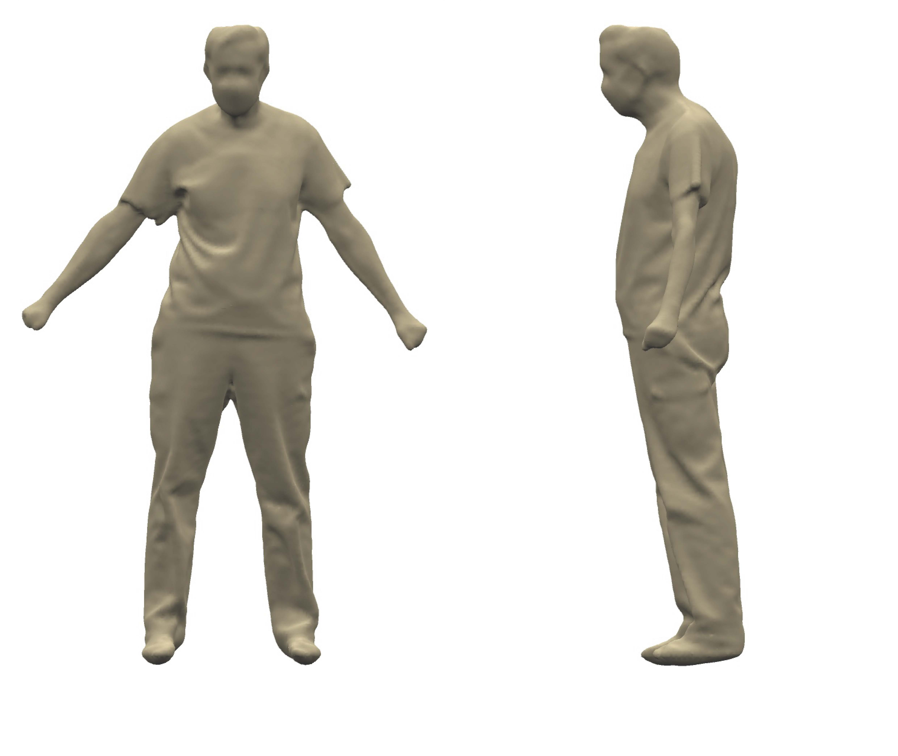
X49™ Body Scans
BEFORE
Age: 74
Gender: Male
Body Fat %: 37.55%
Fat Mass: 66.6 lbs
Fat Free Mass: 109.4lbs
Health Risk: 53% higher than ideal

Slide 17
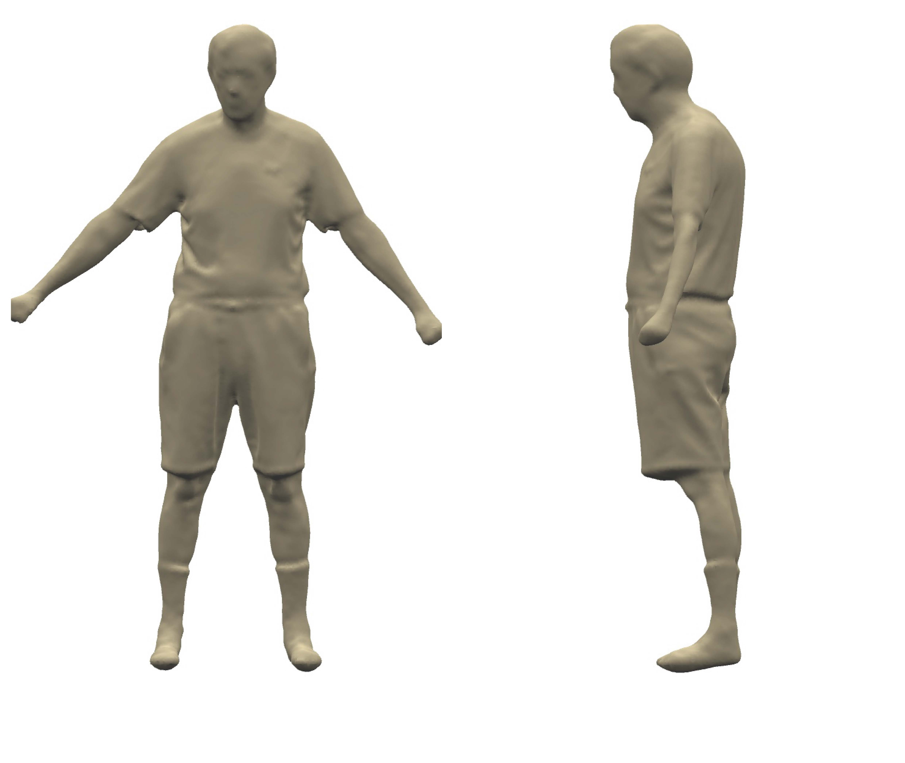
X49™ Body Scans
BEFORE
Age: 74
Gender: Male
Body Fat %: 37.55%
Fat Mass: 66.6 lbs
Fat Free Mass: 109.4lbs
Health Risk: 53% higher than ideal
AFTER
Age: 74
Gender: Male
Body Fat %: 33.5%
Fat Mass: 59.4 lbs
Fat Free Mass: 117.6 lbs
Health Risk: 20% higher than ideal

Slide 18

X49™ Benefits
Strengthen Bones for a rock-solid foundation.
Recover more quickly, despite your age.
Supports the health and function of the heart.

Slide 19
X49™ Benefits
SYSTOLIC
Study results show reduction in blood pressure:
X49™ only
Decrease in systolic by 5.51%
X39® + X49™
Decrease in systolic by 7.75%
Decrease in diastolic of 17.98%
110
70
DIASTOLIC

Slide 20

More
X49™
Benefits
Supports the health and function of the brain.
X49™ is more highly focused on helping those who want to Increase their muscle and reduce body fat as well as seeing improvements to their strength and stamina.
X49™ will benefit the most those who have a consistent diet and exercise program, a healthy cardiovascular system and stay consistently hydrated.

Slide 21
What benefits can I expect from using X39® & X49™ together?

Slide 22
Benefits of using X39® + X49™ together
Using both X39® and X49™ simultaneously will unlock their synergistic benefits.
X39® helps in stem cell enhancement while X49™ helps in reshaping the body and improving body composition.
Using them in tandem will improve the benefits of both products, improving overall health and ability exponentially.

Slide 23
% Improvement X49™ vs. X39® + X49™
X49™ Only
X39® + X49™
Bike (calories burned)
Bike (top speed)
Bike (distance)
Pulse (decrease)
72.73%
22.63%
57.14%
4.04%
Bike (calories burned)
Bike (top speed)
Bike (distance)
Pulse (decrease)
90.91%
27.54%
65.15%
5.38%

Slide 24
Body Changes!
What the data shows:
X39® and X49™ help to build bodies but differently.
Adding X49™ results in increased fat loss (11% points in 60 days).
X49™ makes the body leaner and stronger.
Using X39® and X49™ creates more change.

Slide 25
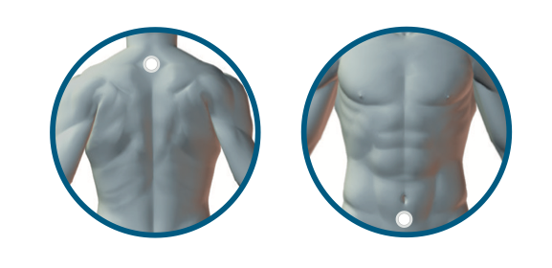
X39® + X49™ Patch Placement
X39® behind the neck
X49™ below the belly button

Slide 26
Performance Bundle

Slide 27
Get the benefits of both with the
Performance Bundle
The Performance Bundle is the best way to experience X39® and X49™ together.
Includes 30 of both X39® and X49™ patches.
Save $20 with a discounted bundle price.
Save a further $10 with a Monthly Subscription Order.
Regular Purchase
Performance Bundle
(Discounted Pricing)
One X39® Sleeve:
One X49™ Sleeve:
TOTAL:
$99.95 | 77BV
$99.95 | 77BV
$199.90
One Performance Bundle:
TOTAL: $179.95 | 156BV+
Performance Bundle
(Regular Order)
Performance Bundle
(Monthly Subscription Order)
TOTAL:
$179.95 | 156BV+
TOTAL:
$169.95 | 156BV+
+Pricing until April 28, 2022 only, thereafter pricing to change to $179.95 | 140BV (Wholesale) and $169.95 | 140BV (Monthly Subscription Order)

Slide 28
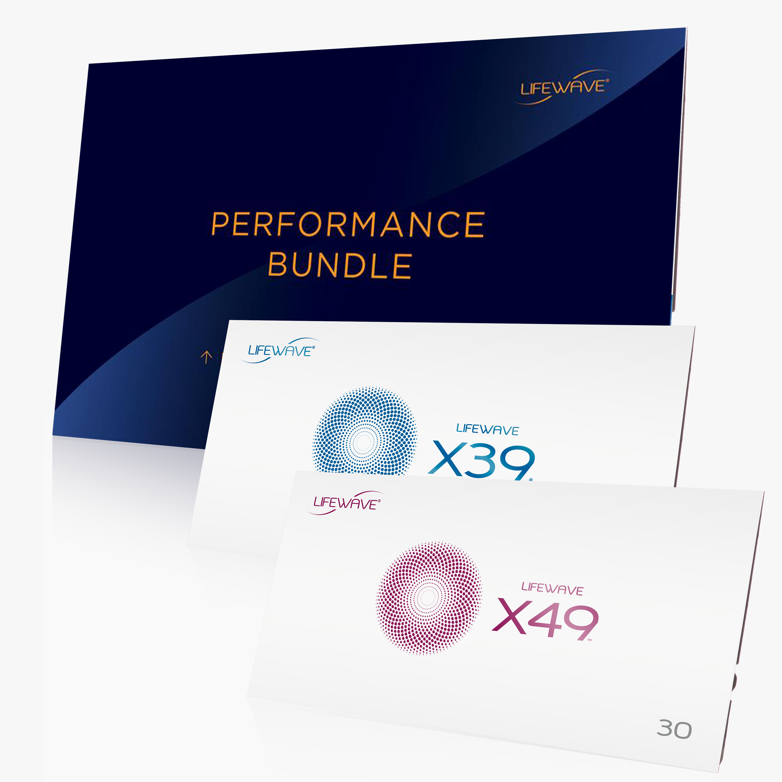
X39® + X49™ Performance Bundle

