Slide 1
The Template Ceremonies
by Juliet and Jiva Carter
With
Maureen St. Germain
Notes:
The Science of Transcendence allows for the acceleration of Source intelligence translated through the human awareness – will also affect mass consciousness transforming the morphogenetic field and ctruction a NEW paradigm of consensus reality. These codes are an intelligent patternaing of information that acts as an alchemical catalyst to active dormant potential

Slide 2
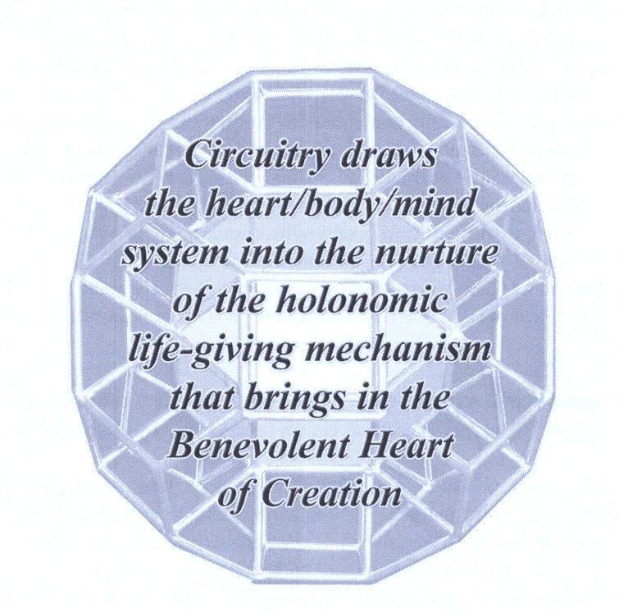
Foundation –
The Ceremony of Original Innocence
Notes:
The Geometric Shapes with few words are Mantras of creation , opening portals into the new paradigm continuum. They alchemically assist assimilation and integration of this information, through RESONANCE!!! The pranic tube (causeway) and Sacred Breath are connected. As you work with these by reprintingh and posting around your home or under your pillow, they will affect not only WHAT you think, but HOW you Think!
The reconnection of the basal 12 circuits is the section we will be working on here.

Slide 3
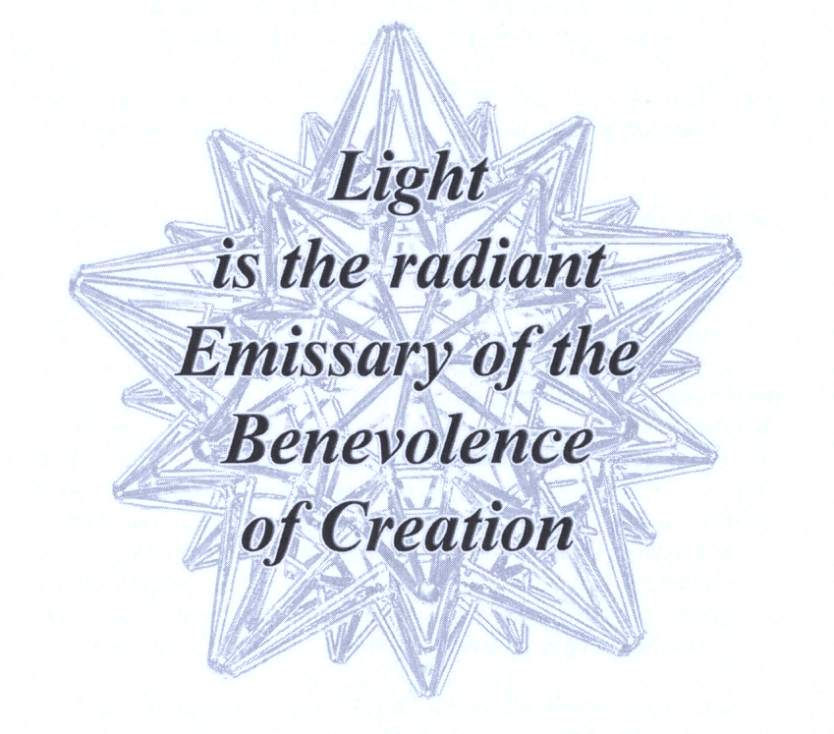
Guilt & Shame will hold you back!
Notes:
What Blends do you know to use for Guilt and Shame? (Crystal Source & Remembranz) What do you feel Guilt about – Shame?

Slide 4
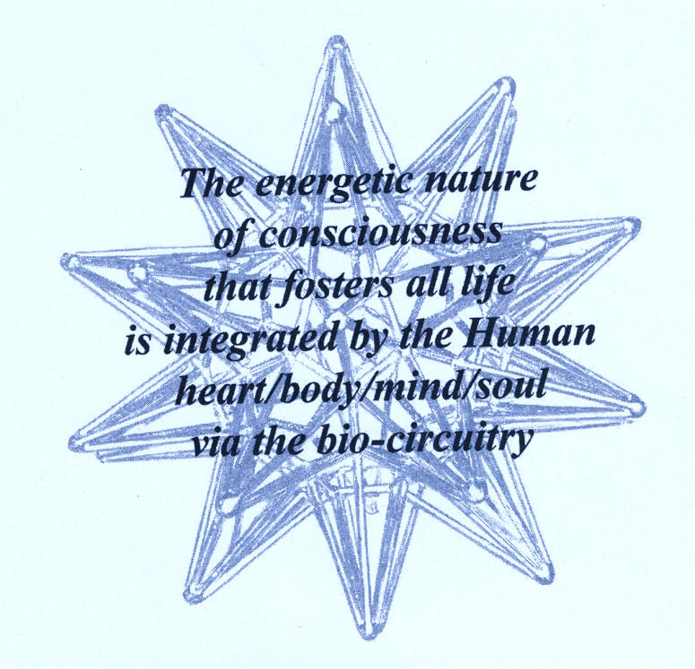
Humanity is connected to all of life!
Notes:
It is incumbent upon us – to find our true nature by shedding the biases we hold and liberating ourselves from the notions of shame, guilt and judgement. Utilizing these light codes will free you to break the barriers of illusion, undo the genetic manipulations and move into resonance with our true divine nature.

Slide 5
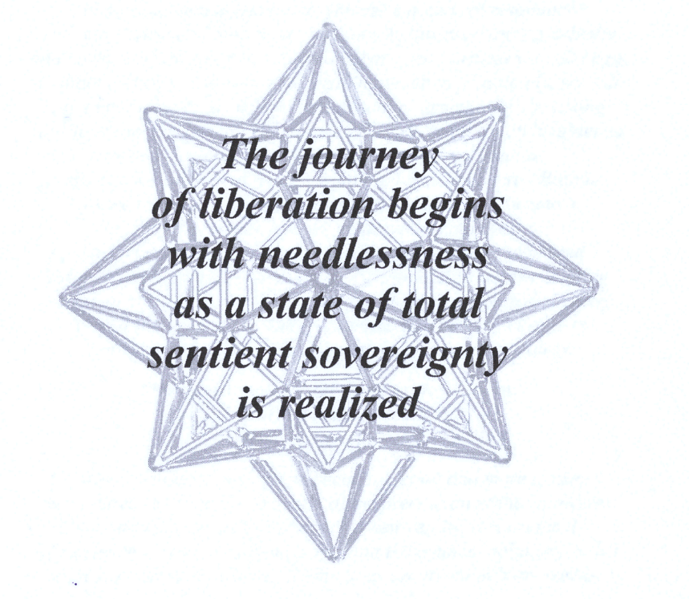
Your mental “Sovereignty” is paramount
Notes:
Junk DNA and old name that has stuck in the minds of many is now understood to be specialized Memory DNA . This shift in understanding emphasizes that non-coding DNA, far from being useless, is essential for many biological processes and disease mechanisms. The term "junk DNA" is gradually being replaced by more accurate descriptions as scientists now recognize the critical roles these non-coding regions of the genome play. Historically, "junk DNA" referred to the large portions of the genome that do not code for proteins, leading some to assume they were useless. However, research has since revealed that much of this DNA, particularly non-coding DNA, has important regulatory functions, such as controlling gene expression, determining DNA's 3D architecture, and impacting genetic variation.
For example, non-coding DNA contains sequences like enhancers and repressors, which are crucial for activating or suppressing genes. These regions also play a role in complex traits and diseases, influencing susceptibility to conditions like type 2 diabetes and coronary artery disease. Instead of calling it "junk DNA," researchers now refer to these regions as "non-coding DNA," with some even likening it to the "dark matter" of the genome because of its yet-to-be-fully-understood functions

Slide 6
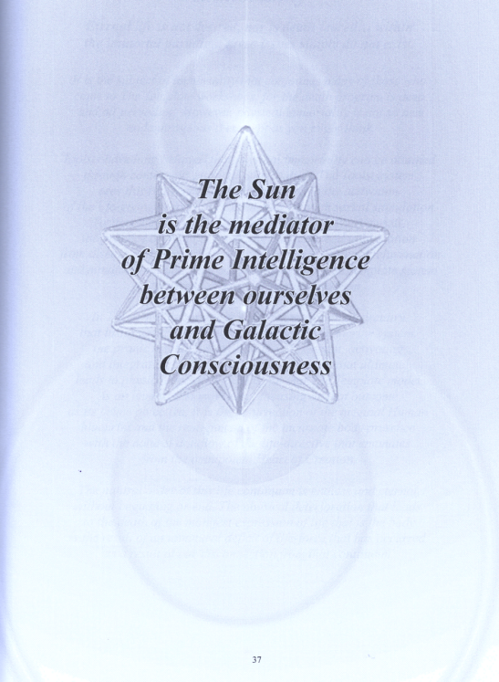
Sunrise & Sunset
Notes:
Use this time to create sacred ceremony: Helios and Vesta, Let the Light flow into my being, Let the Light flow into the center of my heart, let the Light flow into the center of the Earth and let the Earth be transformed into the NEW Day.

Slide 7
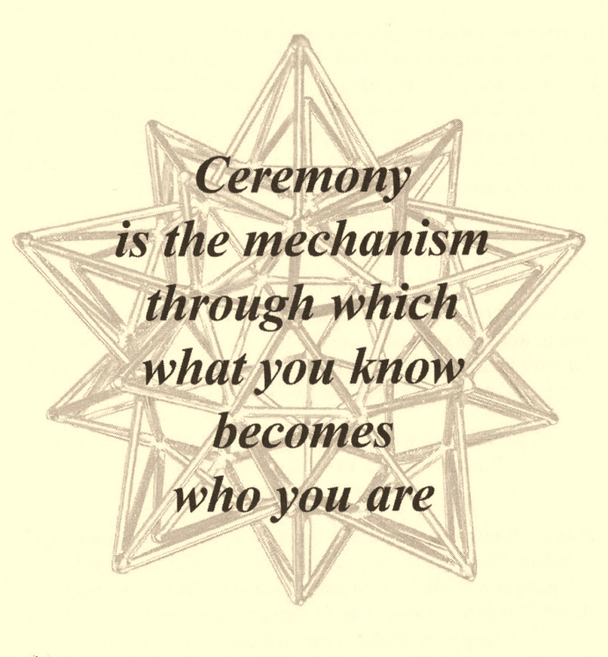
Sacred Ceremony

Slide 8
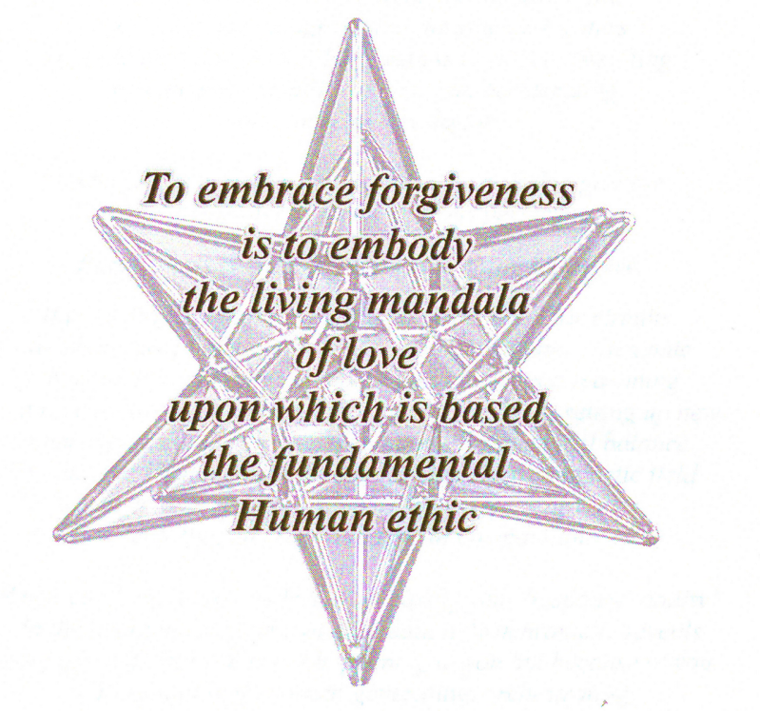
Original Innocence
Notes:
List all the things you want to forgive – in yourself.
We will do a fire ceremony to release your list.

Slide 9
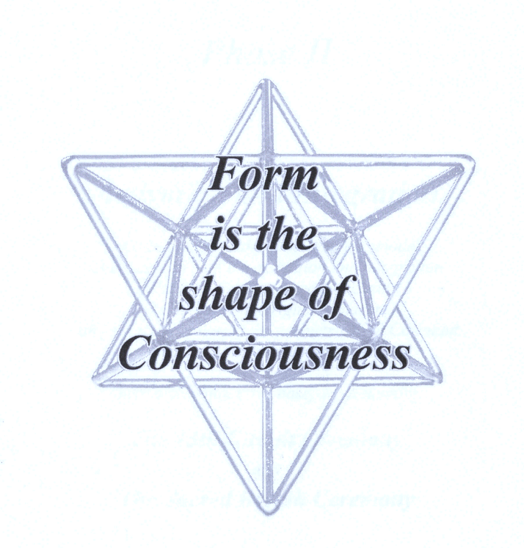
Keep Sacred Geometry – everywhere!
Notes:
Drawing, building, admiring Sacred Geometry aligns your circuitry. Honoring your physical body is paramount.

Slide 10
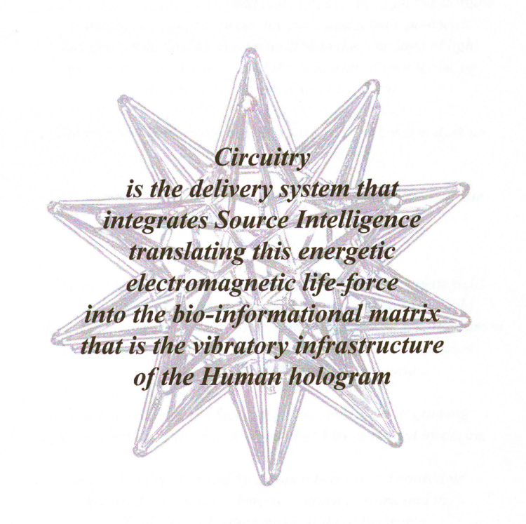
Use the Sacred Geometry
Notes:
To reconnect the endocrine system, Pituitary, hypothalamus and pineal. In most humans these have atrophied.

Slide 11
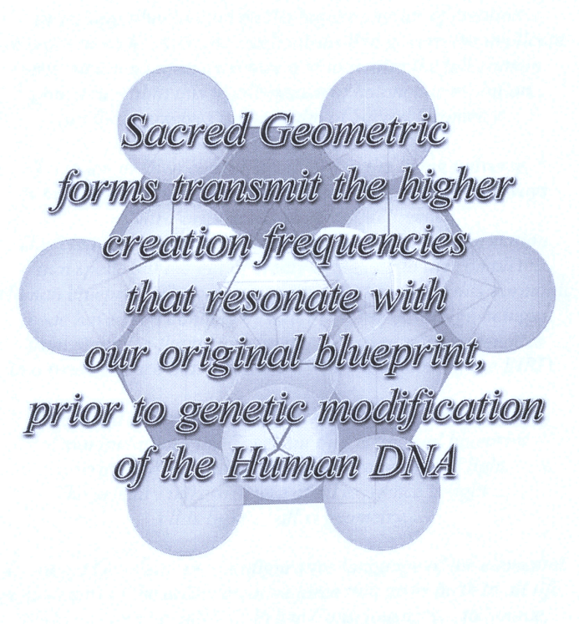
Clear intention to reconnect
Notes:
The endocrine system is the sacred interface between the life directive transmitted from Sourse ad the Human manifestation of athat directive on all levels
As the circuitry delivers this electromagnetic consciousness the chakra centers act as transducers of the enrgy, stepping it down into absorbable data for the entire body system to utilize emotionall, physically and mentally . The relationship between the circuitry , the endocrine glands, the chakras, the DNA and the point of sould evolution is an impeccably interactive and co-creative one, organically regulated by each individual’s capacity for change.

Slide 12
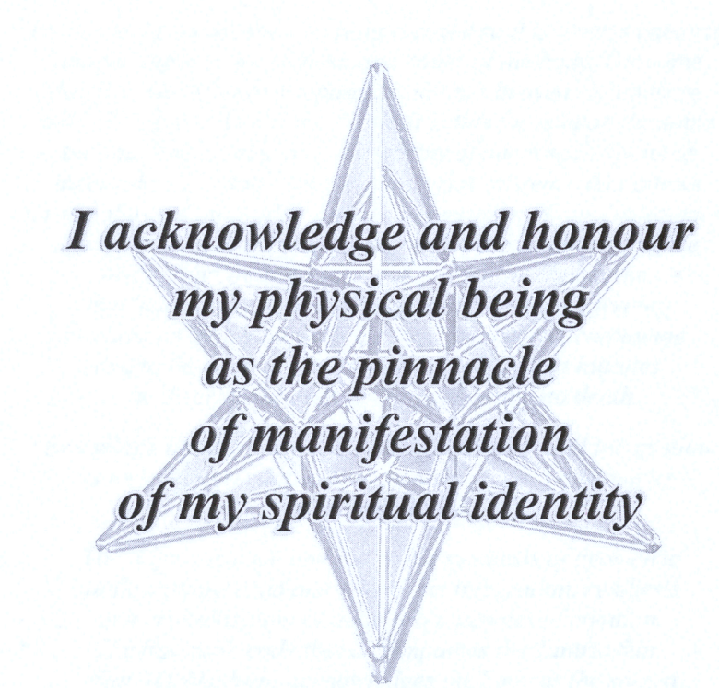
Notes:
This means what you eat, what you breath, what you think about – fills you in both directions. Which direction to do you want to go in.

Slide 13
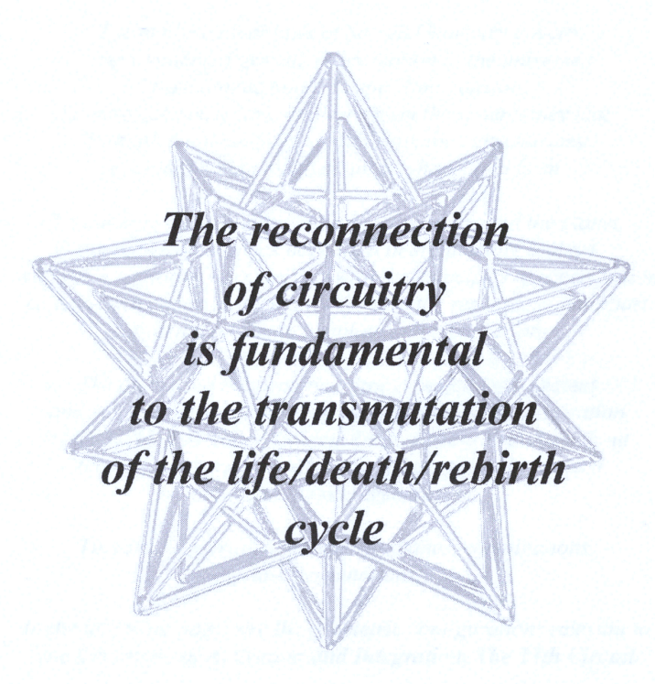
How do you reconnect?
Notes:
Eeman device, the meditations, the pineal activations, sacred geometry, Template ceremonies!

Slide 14
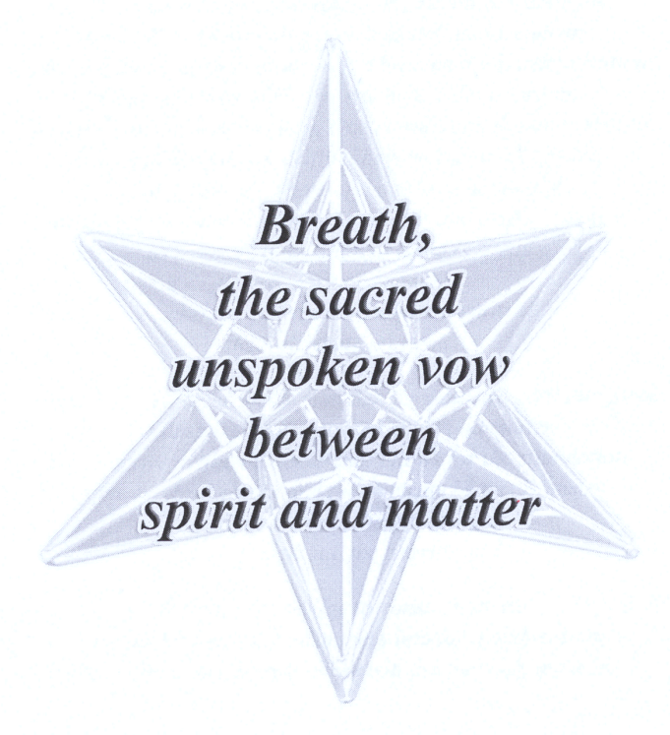
Notes:
Practice breath techniques, explore sun breathing.

Slide 15
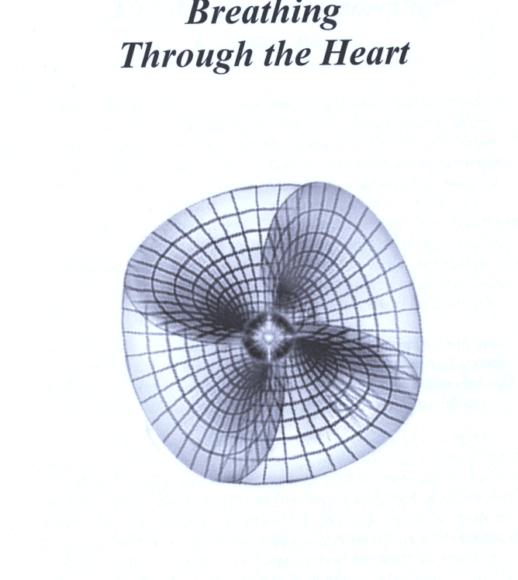
All your attention
Notes:
Using the heart

Slide 16
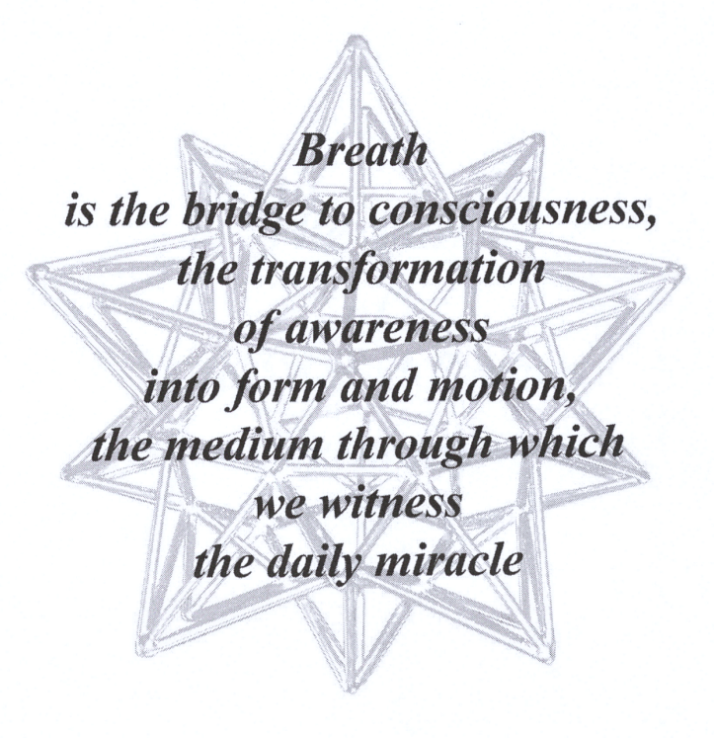

Slide 17
https://portalglastonbury.uk/

